Slide 1
Intro to the Wyeth Family
N.C. Wyeth
Andrew Wyeth
Jamie Wyeth
Notes:
This slideshow is to be more of a catalyst for Oral Storytelling
Ideally, the teacher would introduce the artists and some general historical information as a story and the students will fill in the blanks with their projects and research.

Slide 2
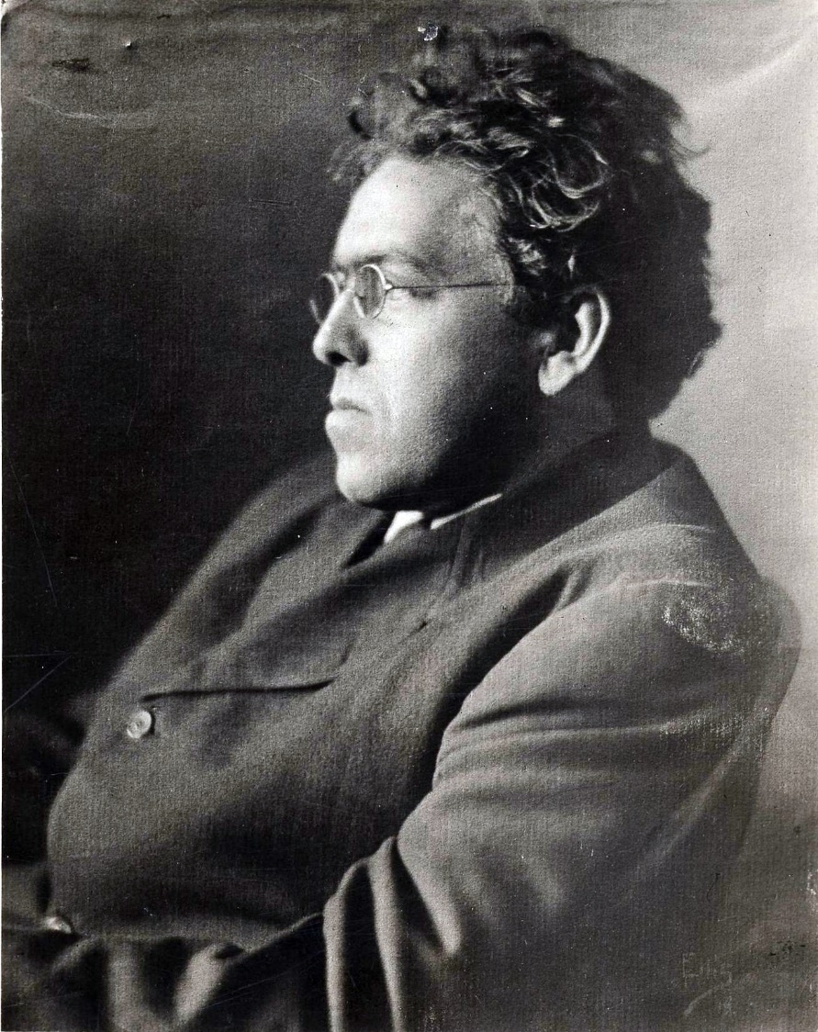
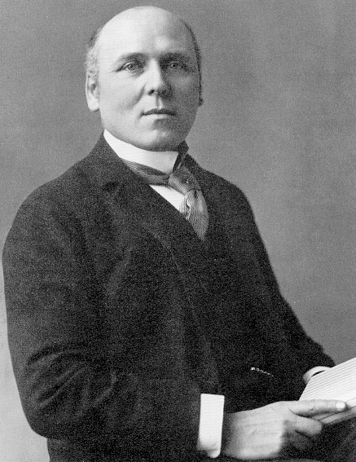
Newell Convers Wyeth
Born Needham, MA on October 22, 1882
Taught by Howard Pyle in Wilmington, DE
Lived most of his life in Chadds Ford, PA
Died October 19, 1945 in Car Accident
Notes:
Howard Pyle was a famous teacher of hundreds of American Artists
Called the “Father of American Illustration”
Howard Pyle School of Art (1900-1905)

Slide 3
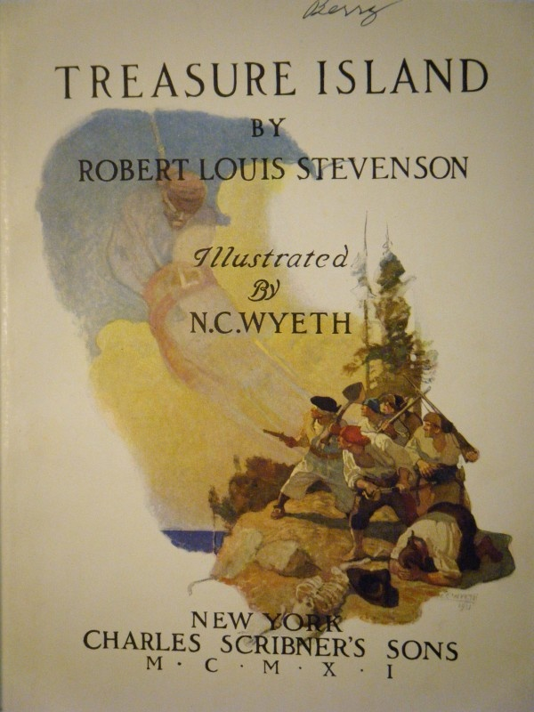
Notes:
N.C. Wyeth was part of the “Golden Age of Illustration”
Robinson Crusoe: 17th Century young man goes to sea and had great adventures around the world. Starting off in England, he ends up in Brazil, makes a life long friend and finds his way back to England to become a rich man.
Treasure Island: An unlikely crew of pirates go after treasure and encounter many challenges along the way.

Slide 4
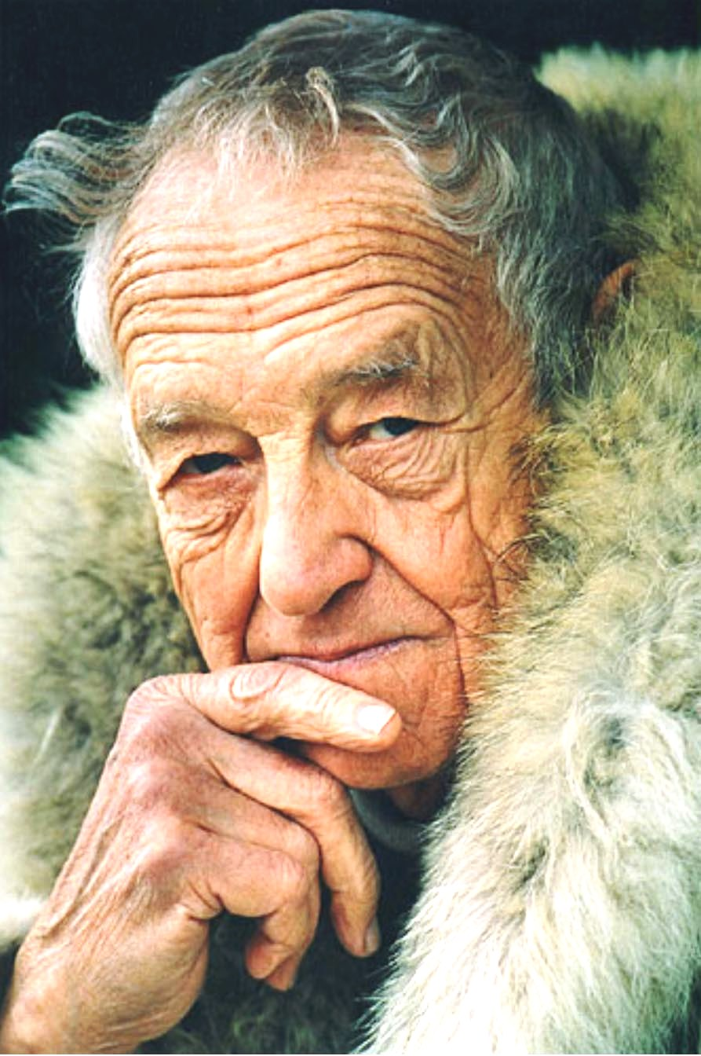
Andrew Newell Wyeth
Born Chadds Ford, PA on July 12, 1917
Taught by his father
Died January 16, 2009
Notes:
Spent his entire life painting.
Taught by his father N.C.
Lived Winters in Chadds Ford, PA
Summers in Cushing, ME

Slide 5
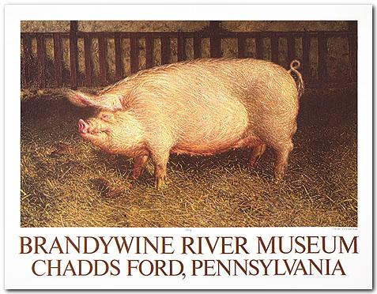
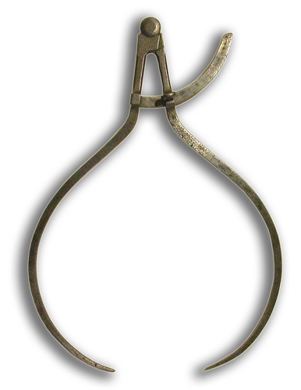
James Browning Wyeth
Born Wilmington, DE on July 16, 1946
Trained privately and studied anatomy
Still Alive Today!
Notes:
Jamie trained privately in art and has spent his entire life devoted to it
He likes to be very precise in his paintings, so much so that he deeply studies his subjects.
This portrait of his pig, DenDen, is to scale and can be seen at the Brandywine River Museum
He used a tool called a caliper to measure DenDen

